Slide 1
Basic Calculator using Python & Tkinter
NextHikes IT Solution Ltd

Slide 2
Introduction
What is Calculator ?
Why Tkinter ?
Tkinter is a built-in library in Python used to create Graphical User Interface (GUI) applications.
It helps us make programs with windows, buttons, labels, text boxes, and menus.
Tkinter allows users to interact using mouse clicks instead of typing commands.
It is easy to learn and suitable for beginners.
Tintern comes pre-installed with Python, so no extra installation is needed.
It is commonly used to build small applications like calculators, forms, and desktop tools.

Slide 3
Objective of the project
To create a basic calculator
To perform simple mathematical operations
To learn GUI programming using Python

Slide 4
Tools Used
Python
Tkinter
VS Code
Github

Slide 5
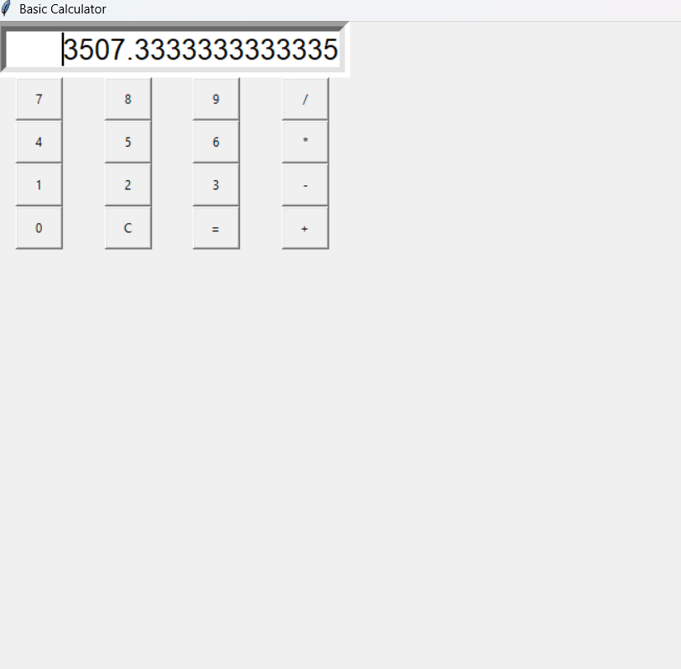
Features
This Python based Calculator which can perform all basic operations Addition , Subtraction , Multiplication and Division .
Shows numbers and results on the display screen.
Has buttons from 0 to 9 to enter numbers.
Supports addition (+).
Supports subtraction (−).
Supports multiplication (*).
Supports division (/).
Equals (=) button calculates the result.
Clear (C) button clears the screen.
Displays decimal results when required.
Shows Error for invalid calculations.
Buttons are clickable and easy to use.
Calculator updates the screen instantly.
Built using Python and Tkinter.
Works like a real calculator.
User-friendly graphical interface.

Slide 6
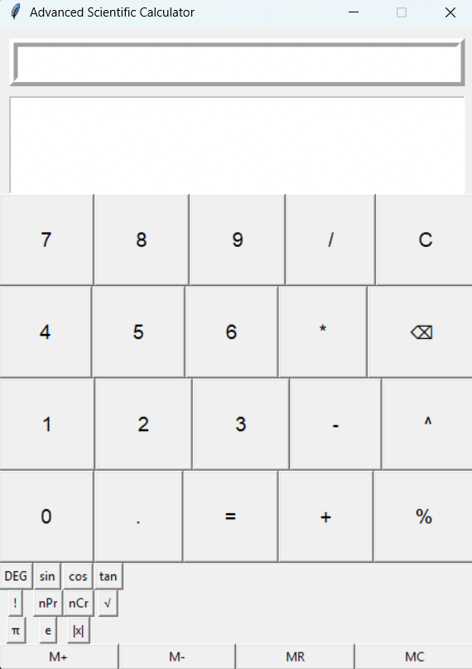
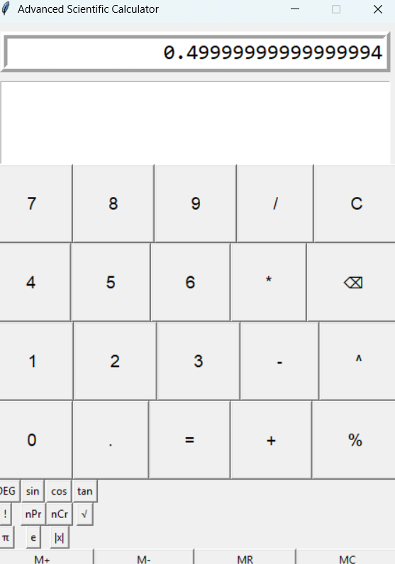
Advanced scientific calculator
Advanced Scientific Calculator helps to solve Complex Calculations such as Sin , Cos , Tan , nPr , nCr , e^x .
Sin 30 = 0.4999999

Slide 7
Working of the calculator
User clicks number buttons
Operators are selected
Expression is shown on the screen
Result is calculated using = button

Slide 8
Learning OUTCOMES
Basics of Python programming
Understanding of Tkinter
GUI application development
Hands-on coding experience

Slide 9
Conclusion
Calculator works correctly
User-friendly interface
Meets project requirements

Slide 10
Thank You

